Slide 1
RCPsych collaboration in Iraq
Prof Mohammed Al-Uzri
Presidential Lead for International Affairs

Slide 2
Appointment of the First National Mental Health Adviser to the Ministery of Health in Iraq (2004)
Establishing the National Mental Health Council

Slide 3

Iraq Sub-Committee (2005)

Slide 4


Slide 5


Slide 6
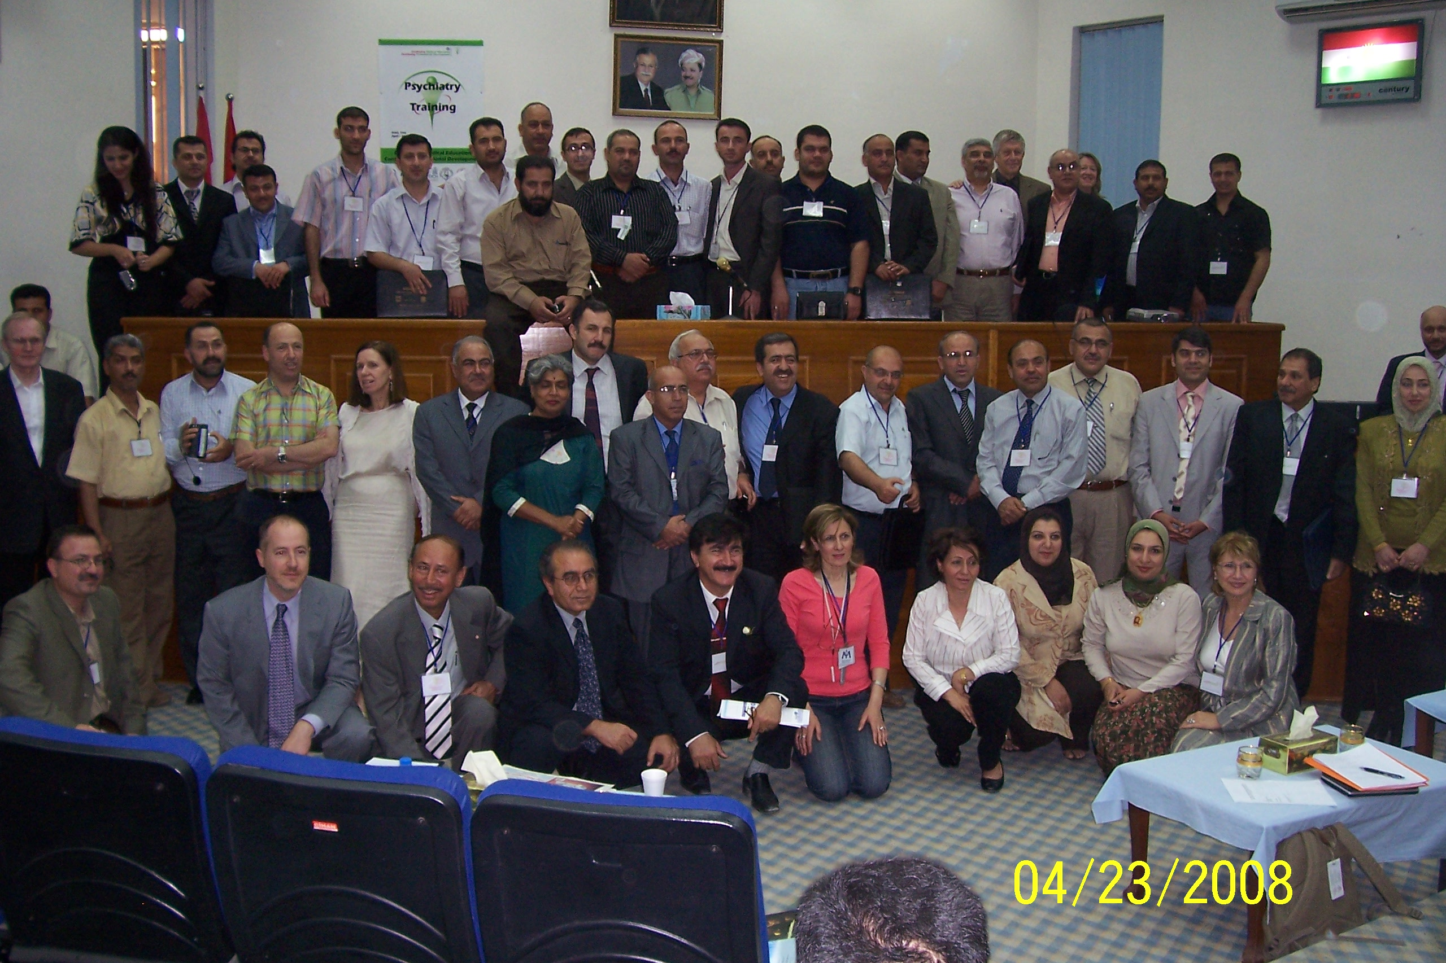

Slide 7
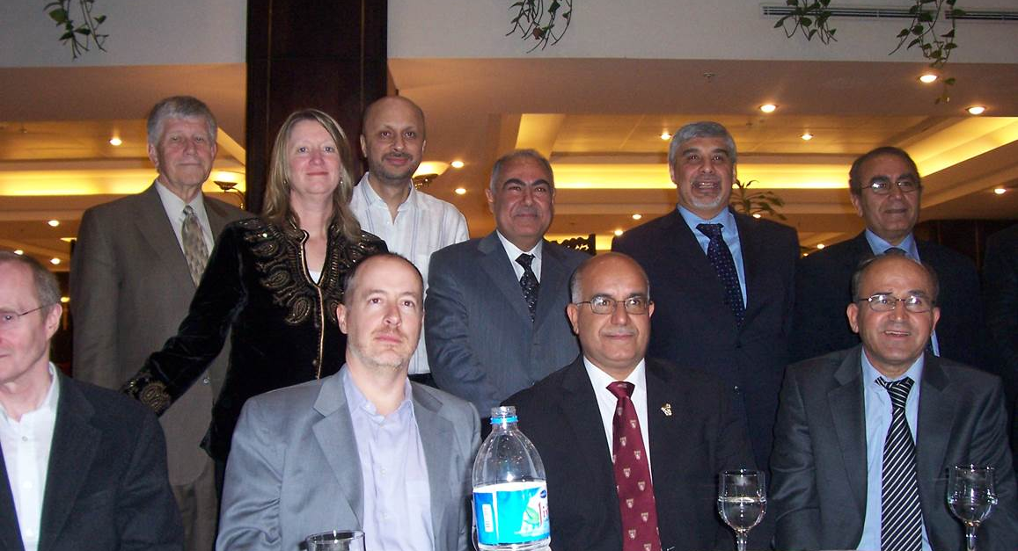

Slide 8

Iraq Mental Health Survey
World Psychiatry8:2- June 2009

Slide 9
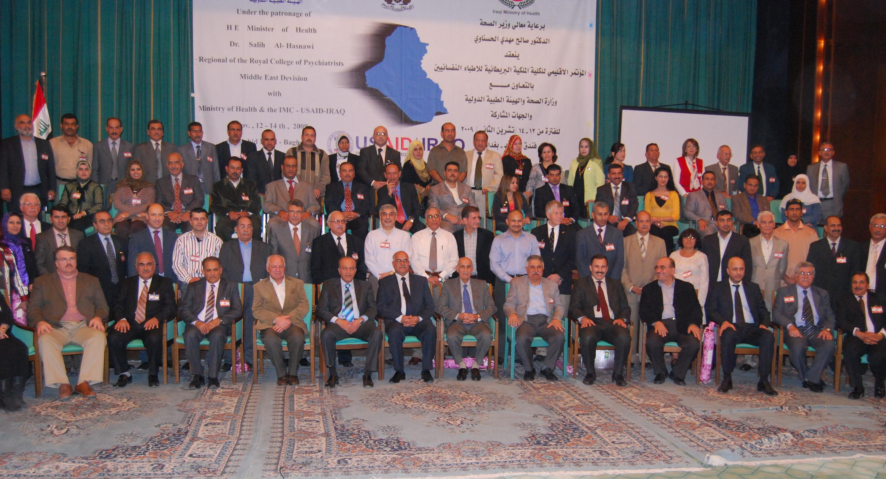
Middle East Division meeting 2009

Slide 10


Slide 11
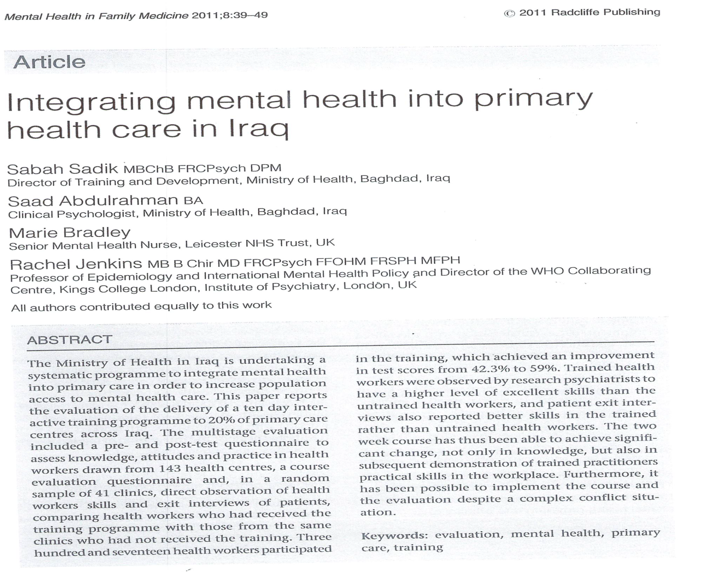

Slide 12
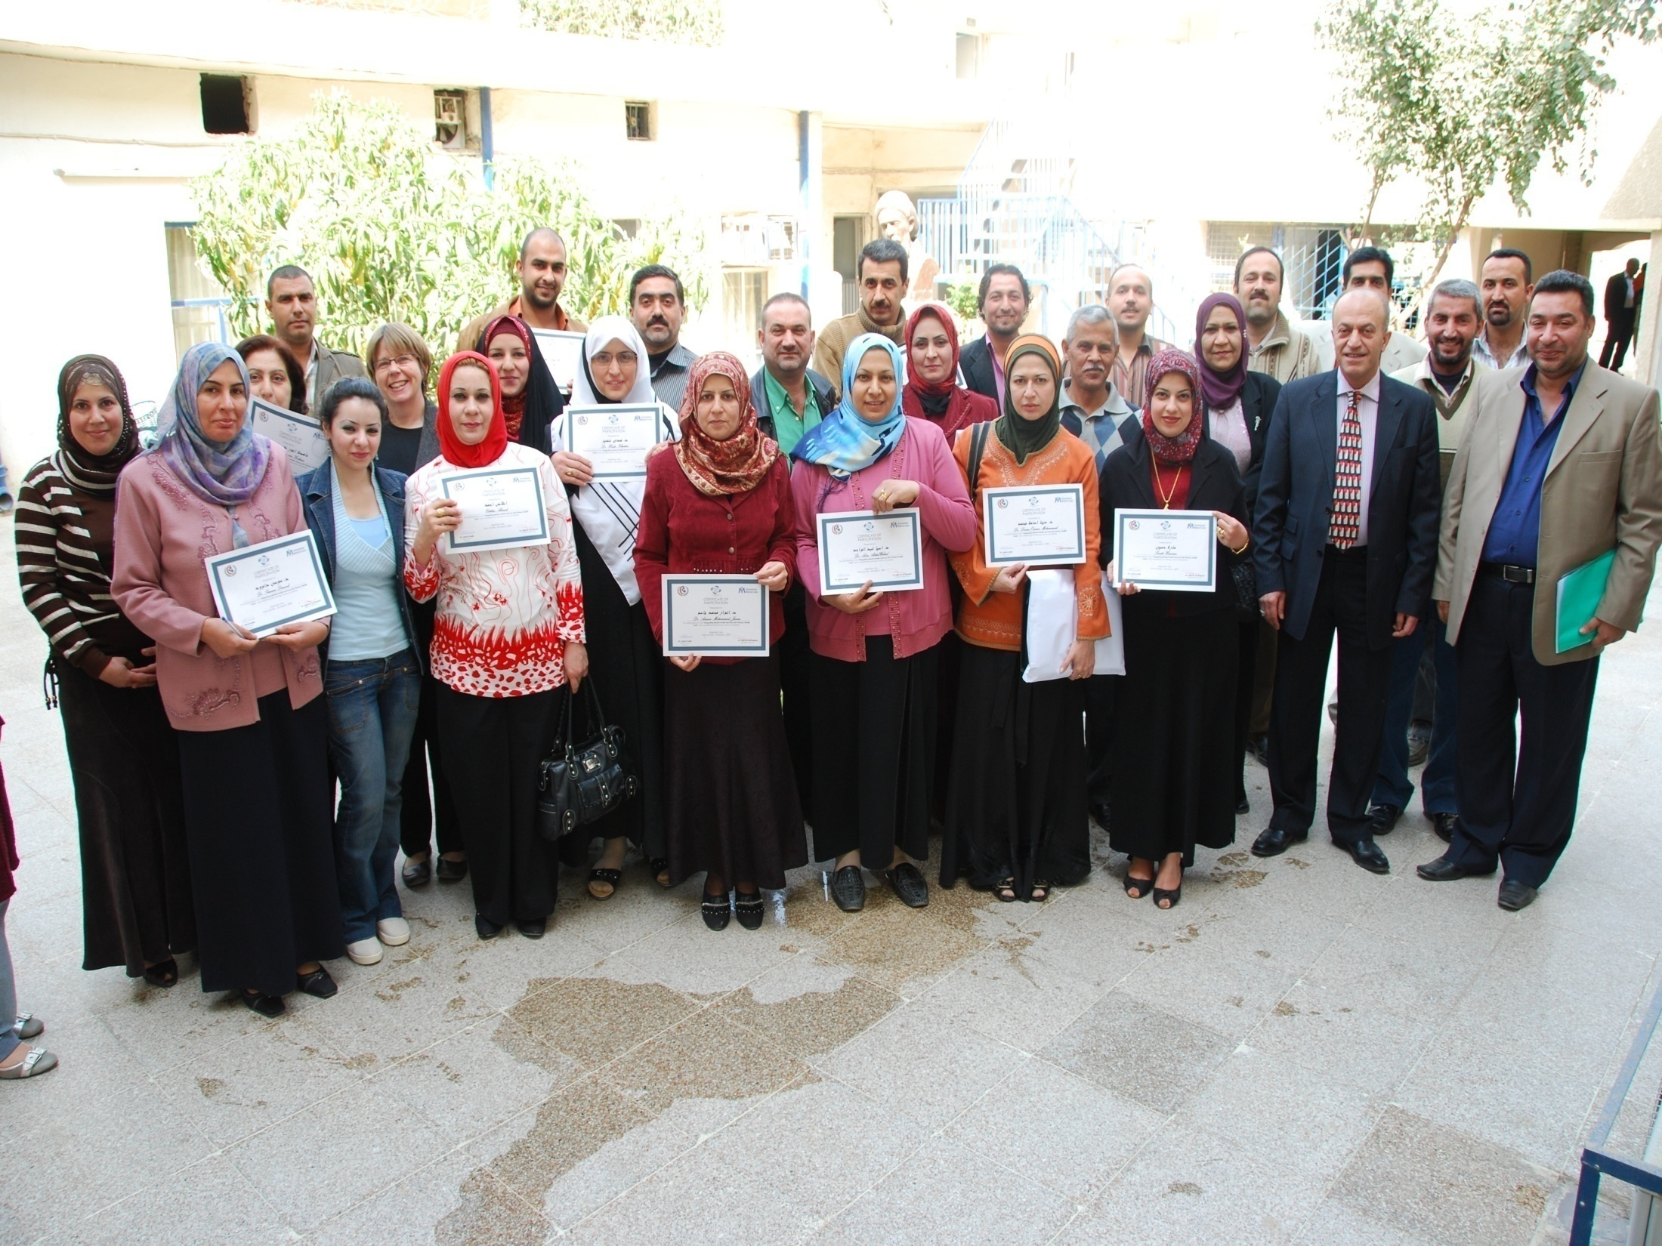

Slide 13
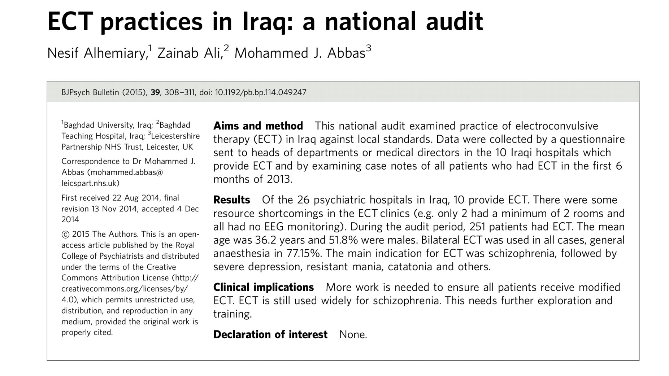

Slide 14


Slide 15
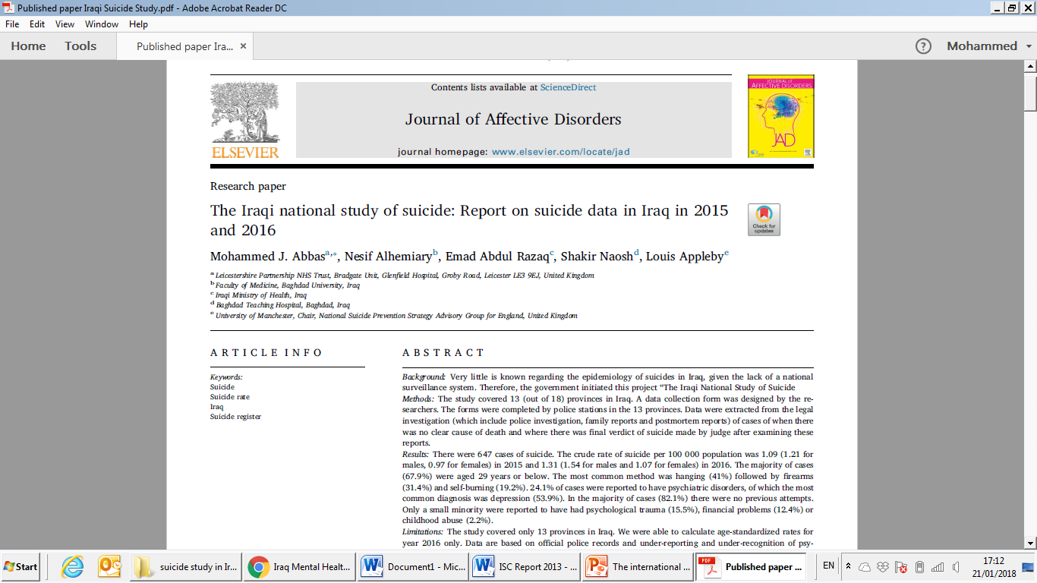

Slide 16
Thank you

